Slide 1
Responsive Design

Slide 2


What is a Responsive Web Site?
Site designed to adapt its layout to the viewing environment by using ﬂuid, proportionAbased grids, ﬂexible images, and CSS3 media queries
Paraphrased from Wikipedia

Slide 3
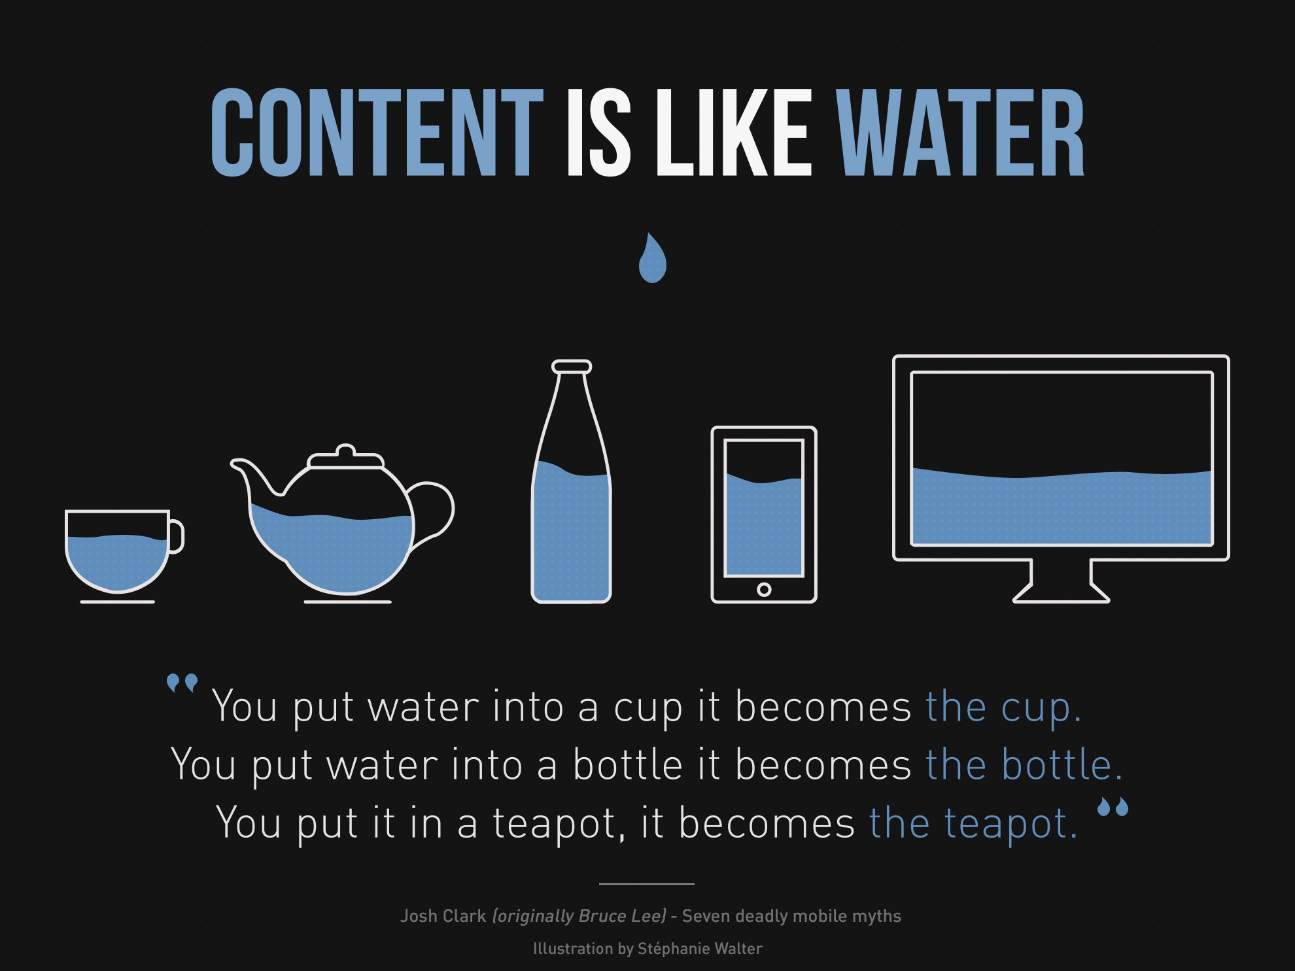

Slide 4



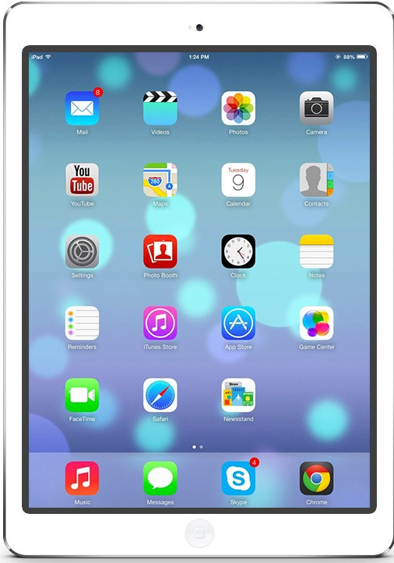
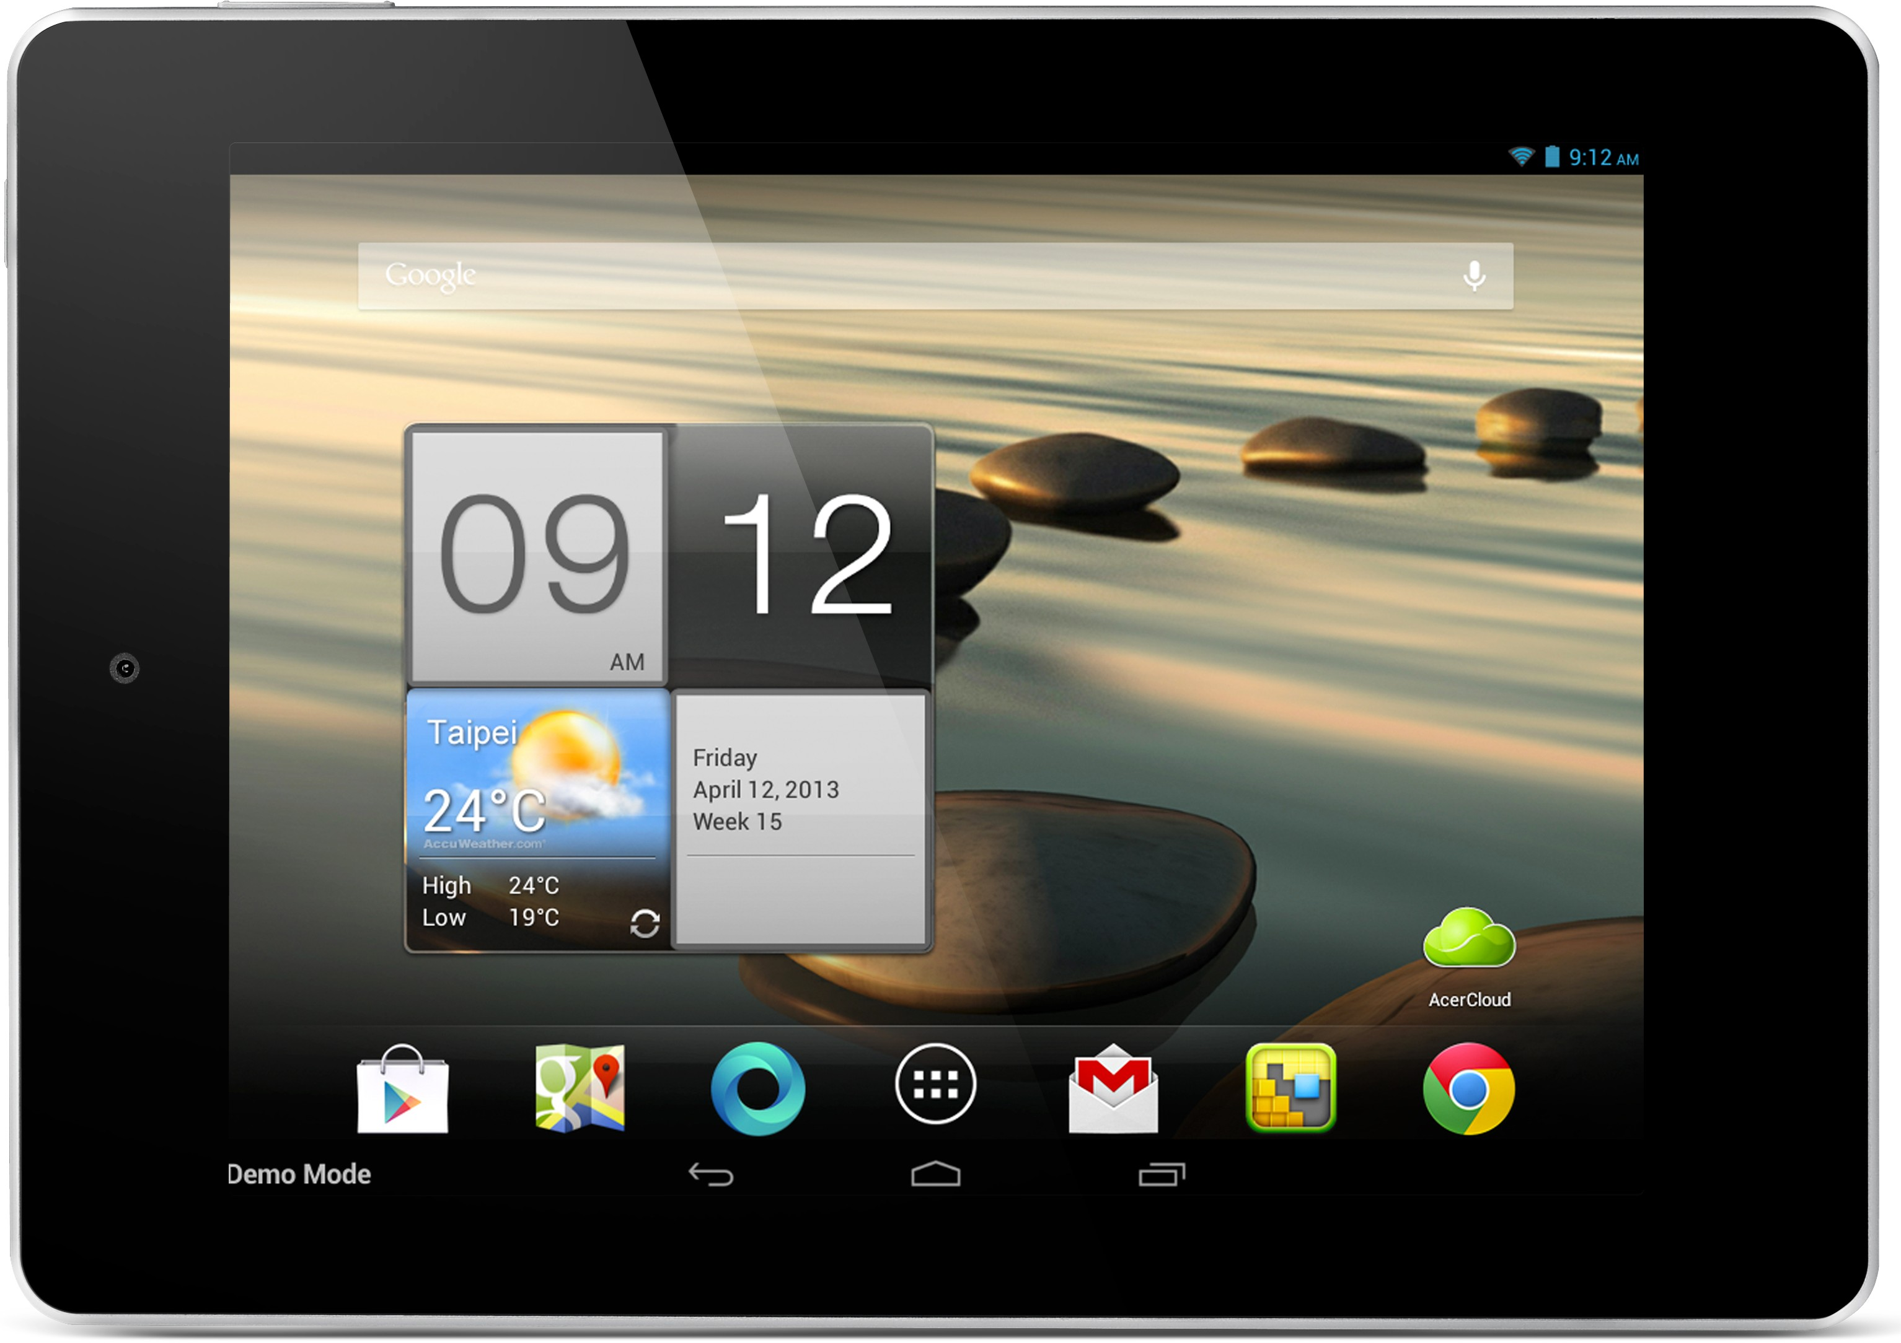

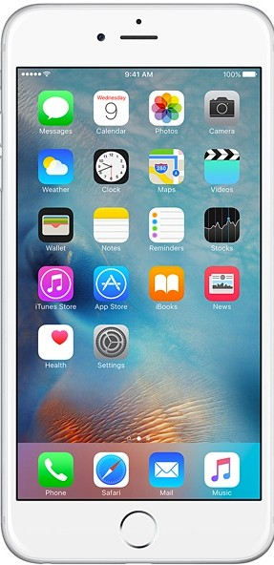


What device do we need to support?
ALL OF THEM

Slide 5
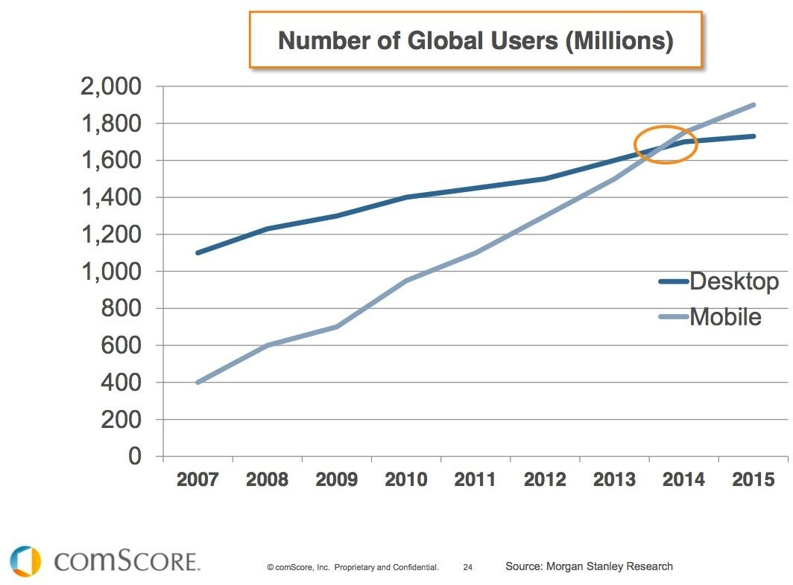

Slide 6












Alternative to Responsive Design:
1.2
Server
m
.mysite.com
Detect User6Agent, i.e., browser
1.3

Slide 7












12-Column Grid Responsive Layout
factors of 12: 1, 2, 3, 4, 6, 12

Slide 8























12-Column Grid Responsive Layout
padding
3
3
3
3
6
6
4
4
4

Slide 9
12-Column Grid Responsive Layout
100%
1 column = 100% / 12 = 8.33%
3 3 3
6
3
6
4 4
4

Slide 10
12-Column Grid Responsive Layout
100%
1 column = 100% / 12 = 8.33%
25% 25% 25%
25%
50%
%
50
33.
33%
33.
33%
33.33%

Slide 11












12-Column Grid Responsive Layout
Nested grids
4 4
4
6
6 3 3 3
3
4
4
4

Slide 12
Summary
 Need and idea of responsive design
 12-column grid layout
Use % to achieve fluid width (wrt browser width)
 Viewport meta tag to turn off default mobile zooming

